Slide 1
CS 471/571
Ch6 Quality Assurance

Slide 2
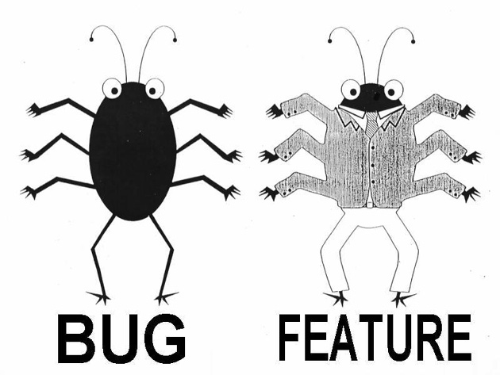
It is not a bug; it is a feature!
Notes:
Bug or feature: dots in public x.y.z@gmail.com do not make difference – some people argue that it is a bug. But it is a feature by design. Google Apps for enterprises do not use dot by default.
Having bugs is a feature of software.

Slide 3
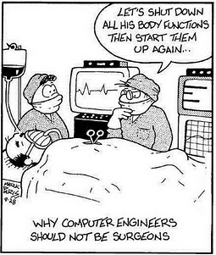

Slide 4
Overview
Introduction to quality assurance
Execution-based testing
    Testing strategies
    Coverage criteria
    Partitioning and boundary value analysis
  Review and static analysis
Correctness proofs
    Theorem proving, model checking

Slide 5
Software Quality
Correctness: satisfies its specifications
Utility
  The extent to which the product meets the user’s needs: ease of use, useful functions, cost effectiveness
Reliability
  A measure of the frequency and criticality of failure
  Mean time between failures; mean time/cost to repair
Robustness
  The possibility of unacceptable results with valid input
  The effect of invalid input
Performance
  The extent to which space and time constraints are met

Slide 6
Software Quality Assurance
Quality assurance - preventing bugs
  Quality must be built in from the beginning
  The earlier in the process a bug is discovered and corrected, the cheaper the correction.
SQA Group
  Managerial independence between development and SQA
    Neither group should have power over the other
  More senior management must decide whether to
    Deliver the product on time but with faults, or
    Test further and deliver the product late
  The decision must take into account the interests of the client and the development organization

Slide 7
Software Quality Assurance - cont
The members of SQA must ensure that the developers are doing high-quality work
  At the end of each workflow
  When the product is complete
QA must be applied to the process itself
  Example: Standards
Verification
  Determine if the workflow was completed correctly
Validation
  Determine if the product as a whole satisfies its requirements

Slide 8
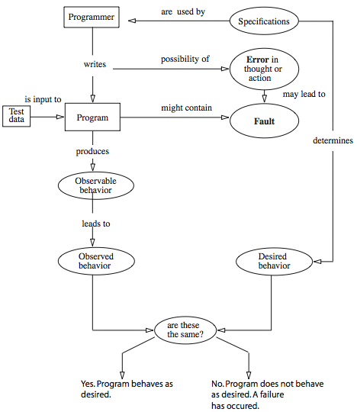
Errors, Faults, and Failures

Slide 9
Myer’s Definition of Software Testing
Definition: Testing is the process of executing a program with the intent of finding errors
Implications
  Assume that the program contains errors and then test the program to find as many errors as possible
  Testing is a destructive process (except in TDD)
  How test cases should be designed
    A good test is one that has a high probability of detecting an as-yet undiscovered error
    A successful test is one that detects an error
From Glen Myers, The Art of Software Testing

Slide 10
Incorrect/Inaccurate Statements
Testing is the process of demonstrating that errors are not present.
The purpose of testing is to show a program performs its intended functions correctly.
Testing is the process of establishing confidence that a program does what is supposed to do.

Slide 11
An Exercise
The program reads three integer values, as the lengths of the sides of a triangle.
The program prints a message that states whether the triangle is scalene, isosceles, or equilateral.
Write a set of test cases that would adequately test this program.

Slide 12
Myers’ Answer
1. Test case for a valid scalene triangle
2. Test case for a valid equilateral triangle
3: Test case for a valid isosceles triangle
4: All permutations of (3): (a=b, b=c, a=c)
5: Test case in which one side has zero value
6: Test case in which one side has a negative value
7: Test case where sum of two numbers equals the third
8. All permutations of (7): a+b=c, a+c=b, b+c=a
9: Sum of two numbers is less than the third (e.g. 1,2,4)
10: All permutations of (9)
11: Test case in which all sides are 0
12: Test case with non-integer values
13: Test case with wrong number of values (too many, too few)
14: For each test case, did you specify the expected output?
Highly experienced professional programmers: 7.8 out of 14.

Slide 13
Testing Strategies
White-Box testing
  Examine the internal program structure
  Example: Coverage criteria
Black Box testing?
  View the program under test as a black box.
  Unconcerned about the internal program structure
  Example: Equivalent classes and boundary value analysis
Hybrid/Gray-Box testing?
  Combine blackbox and whitebox strategies
  Example: derive tests from both specifications and code coverage

Slide 14
Coverage Criteria
Statement coverage
  Test every statement at least once.
Branch coverage
  Test all statements and all branches
Multi-condition coverage
  Test all possible combinations
Additional coverage for OOP
  Method coverage
  Class/interface coverage
  Package coverage

Slide 15
Coverage Criteria - cont
    IF (x>0 && y>0)
    THEN print (x, y);
    x+=y; // not else
Tests to achieve statement coverage
  One test making x>0 && y>0 true, e.g., x=1, y=2
Tests to achieve branch coverage
  Two tests: making the condition true once and false once
Tests to achieve multi-condition coverage
  Four tests satisfying:
  (a) x>0 && y>0 (b) x>0 && y<=0:
  (c) x<=0 && y>0 (d) x<=0 && y<=0

Slide 16
EclEmma: Java Coverage for Eclipse
http://www.eclemma.org/
Example: BankAccount
  Tests in the main methods
  Junit tests

Slide 17
What coverage criteria can reveal the bug?
void give_change(int price) {
  int n_100, n_25, n_10, n_5;
  if (deposit <=price) { change_due =0; }
  else { change_due = deposit – price;
  n_100 = change_due/100;
  change_due = change_due – n_100*100;
  n_25 = change_due/25;
  change_due = change_due – n_25*25;
  n_10 = change_due/10;
  change_due = change_due – n_10*10;
  n_5 = change_due/10; // should be 5
  }
// …}
// compute the number of dollar bills, quarters, dimes, and nickels
// to be returned when a purchase is made from a vending machine

Slide 18
Dark Side of Coverage
No coverage criterion guarantees the detection
  Unless values for deposit and price are such that at least one nickel should be returned.
This bug could be found by a single test that included revealing values of deposit & price.
Coverage/path testing alone is not complete testing.
  Another example: A=B/C;

Slide 19
Equivalence Partitioning
What subset of all possible test cases has the highest probability of detecting the most errors, given constraints on time, cost, computer time?
Considerations on the Subset
  Each test should invoke as many different input conditions as possible to minimize the total number of tests necessary
    To develop a minimal set of test cases
  Partition the input domain into classes
    To develop a set of ‘interesting’ conditions

Slide 20
Equivalence Partitioning - cont
Two tests belong to the same equivalence class if you expect the same result (pass / fail).
  If a test in a class detects an error, all other tests in the class would be expected to find the same one.
  if a case in a class did not detect an error, no other cases in the class would be expected to find an error
    Unless the class falls within another class
  Testing multiple members of the same equivalence class is redundant testing.

Slide 21
Identifying Equivalence Classes - cont
Heuristic, subjective process
  Different people may come up with different classes
  If any reason to believe that elements in a class are not handled in an identical manner, split it into smaller ones
Don’t forget classes for invalid inputs
  At least four classes for input of integer in range 1-99, valid, <1, >99, non-numeric
Organize classifications in a table or an outline

Slide 22
Tabular Format for Equivalence Classes
Input/output | Valid Class | Invalid Class
Enter a number | Numbers between 1 and 99 | <1, >99, Invalid number, Negative number, Letters and non-numeric chars
Enter the first letter of a name | Capital letter Lower-case letter | Non-letter
Draw a line | 1 dot - 4 inches long | No line (length=0), Longer than 4 in Not a line

Slide 23
Equivalence Classes - Examples
Look for ranges of numbers
Look for membership in a group
  one valid class, one invalid
Look for variables that must be equal
Analyze responses to lists and menus
  (Y/N), Y/y, N/n, invalid
Create time-determined classes
  Press spacebar just before, during, after the computer finishes reading from the disk.
Look for variable groups that must calculate to a certain value or range
  Three angles of a triangle: one valid, two invalid

Slide 24
Motivating Exercise
Specification
  if (x>=1)
  then print(x);
  else print(x+1);
Test cases for revealing the following bugs?
  Code 1: if (x>1)
  then print(x);
  else print(x+1);
  Code 2: x>=0
  Code 3: x==1
  Code 4: x>=10
  Code 5: x>=1 && x!=10

Slide 25
Boundaries
Mark the point or zone of transition from one equivalence class to another.
The program is more likely to fail at a boundary, so these are the best members of equivalence classes to use.
Boundary values are the biggest, smallest, soonest, shortest, loudest, fastest, ugliest members of a class – the most extreme values
Incorrect inequalities (e.g. > instead of >=) causes only at the boundaries
Programs that fail with non-boundary values usually fail at the boundaries too.

Slide 26
Boundary Value Analysis
Test each edge of an equivalence class,
  On all sides of each edge (on, above, below)
Many testers include a mid-range value in tests.
  Time permitting, this is a good practice
Examples
  If the valid input range is 1 to 99,
    the valid cases are 1 and 99.
    Use 0 and 100 as tests of invalid input
  If a program writes checks from $1 to $99,
    Can you make it write a check for a negative amount, for $0 or $100? Maybe you can’t, but try.

Slide 27
Review Question
If the program expects an uppercase letter,
Use tests A and Z for the valid class. What about tests for the invalid classes?
@ : ASCII code just below the code for A,
{: just beyond Z (not obvious).
Try a and z too.

Slide 28
Review Question
Specification
  Input ch: [A..F]
  Output: ch-’A’+10
All test Cases ( Partitioning + BVA )?
Suppose none of the test cases finds an error, can we assert that the program is correct?

Slide 29
Motivating Example
“Enter book type (Hardcover, Softcover, Loose) and amount (1-99)”
  Valid class? Invalid classes?
  (XYZ, 0) is a good test case?
Test case (XYZ, 0) expresses two error conditions
  It will probably not exercise the check for amount
  The program may say ‘XYZ is unknown book type’ and not bother to examine the remainder of the input
    If (type not in {}) return error;
    If (amount not in 1..99) return error;

Slide 30
Partitioning & BVA - Defining Tests
Assign a unique number to each equivalent class
Write a new test case covering as many of the uncovered valid classes as possible
  Until all valid equivalence classes have been covered by test cases
Write a new case that covers one and only one of the uncovered invalid classes
  Until all invalid classes have been covered by tests,
  Certain erroneous-input checks mask or supercede other erroneous-input checks

Slide 31
Defining Tests -cont
Method under test: m(x, y), where x>=0, y>=0
Partitioning and boundaries:
  x=1 (valid class), 0 (valid), -1 (invalid)
  y=1(valid), 0 (valid), -1(invalid)
Tests:
  (1, 1) // both from valid classes
  (0, 0) // both from valid classes
  (-1, 1) // only one from invalid class
  (1, -1) // only one from invalid class

Slide 32
Reviews:
Non-Execution-Based Testing
Underlying principles
  We should not review our own work
  Group synergy
Applicable to all artifacts
  Including code review
Approaches
  Walkthrough
  Inspection

Slide 33
Walkthroughs
Walkthrough team: 4-6 six members
  A member of the SQA group (probably chair)
  A member of the team for the current workflow
  A member of the team for the next workflow
Walkthrough is preceded by preparation
  Lists of items not understood; appear to be incorrect
A walkthrough detect faults, not correct them
  Not all items flagged are actually incorrect
  A walkthrough should not last longer than 2 hours
  There is no time to correct faults as well
A walkthrough is NOT performance appraisal

Slide 34
Inspections
Inspection team: four members
  Moderator
  A member of the team for the current workflow
  A member of the team for the next workflow
  A member of the SQA group
Five formal steps
  Overview
  Preparation, aided by statistics of fault types
  Inspection
  Rework
  Follow-up

Slide 35
Fault Statistics
Faults are recorded by severity
  Example: major or minor
Faults are recorded by fault type
  Examples of design faults:
    Not all specification items have been addressed
    Actual and formal arguments do not correspond
For a given workflow, we compare current fault rates with those of previous products
  Take action if there are a disproportionate number of faults
Carry forward statistics to the next workflow
  We may not detect all faults of a particular type in the current inspection

Slide 36
Statistics on Inspections
IBM inspections showed up
  82% of all detected faults (1976)
  70% of all detected faults (1978)
  93% of all detected faults (1986)
Switching system
  90% decrease in the cost of detecting faults (1986)
JPL
  Four major faults, 14 minor faults per 2 hours (1990)
  Savings of $25,000 per inspection
  The number of faults decreased exponentially by phase (1992)

Slide 37
Strengths and Weaknesses of Reviews
Reviews can be effective
  Faults are detected early in the process
Reviews are less effective if the process is inadequate
  Large-scale software should consist of smaller, largely independent pieces
  The documentation of the previous workflows has to be complete and available online

Slide 38
Metrics for Inspections
Inspection rate
  Design pages inspected per hour
Fault density
  Faults per KLOC inspected
Fault detection rate
  Faults detected per hour
Fault detection efficiency
  Number of major, minor faults detected per hour
Does a 50% increase in the fault detection rate mean that quality has decreased? Or the inspection process is more efficient?

Slide 39
Static Program Analysis
Analysis of source/binary code without actually executing the code
Coverity
  Find defects and security vulnerabilities in C, C++, Java, C# code.
  In 2008, took in a $22 million investment.
PMD: A Tool for Eclipse/Java
  http://pmd.sourceforge.net/pmd-5.0.5/
  What Does PMD Mean?
    http://pmd.sourceforge.net/pmd-5.0.5/meaning.html

Slide 40
Sample PMD Rules: Empty code
public void doSomething() {
try {
FileInputStream fis = new FileInputStream("/bugger");
} catch (IOException ioe) {
// not good
}
}

Slide 41
Sample PMD Rules: Coupling
If the number of attributes, local variables, and return types within an object is higher than the specified threshold, it can indicate a high degree of coupling
  import com.Blah;
  import org.Bar;
  import org.Bardo;
  public class Foo {
  private Blah var1;
  private Bar var2;
  //followed by many imports of unique objects
  void ObjectC doWork() {
  Bardo var55;
  ObjectA var44;
  ObjectZ var93;
  return something;
  }
  }

Slide 42
PMD: Simplifying Return
public boolean isBarEqualTo(int x) {
if (bar == x) {
return true;
} else {
return false;
}
}
public boolean isBarEqualTo(int x) {
return bar == x;
}

Slide 43
PMD: Return in Finally Block
Avoid returning from a finally block, this can discard exceptions.
public class Bar {
public String foo() {
try {… ;
} catch (Exception e) {
throw e;
} finally {
return "A. O. K."; // return not recommended here
}
}
}

Slide 44
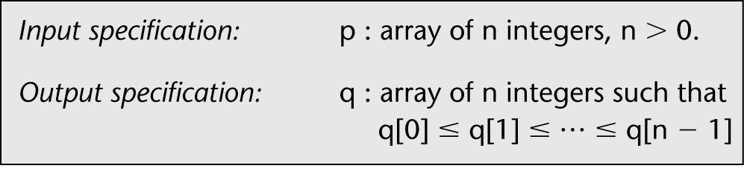
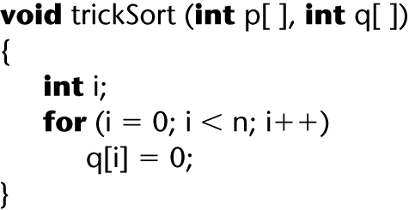
Correctness of Specifications
Incorrect specification for a sort:
Function trickSort satisfies this specification:

Slide 45
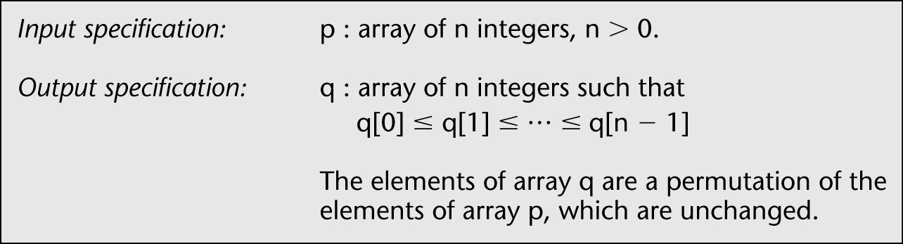
Correctness of Specifications (contd)
Incorrect specification for a sort:
Corrected specification for the sort:
Notes:
How to formally describe “permutation”?
Incorrect: for any p(i), there is q(j) such that p(i)=q(j). If p has duplicate elements, q could have elements not in p.

Slide 46
Correctness Proofs
Correctness proof
  The correct output is produced if the program successfully completes.
Proofs are a vital tool, where appropriate:
  When human lives are at stake
  When indicated by cost–benefit analysis
  When the risk of not proving is too great
Informal proofs
Formal proofs
  Theorem proving
  Model checking

Slide 47
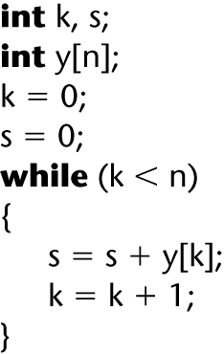
Example of a Correctness Proof
The code segment to be proven correct
Input spec: n is positive integer
Output spec: k=n and s= y[0]+y[1]+….+y[n-1]

Slide 48
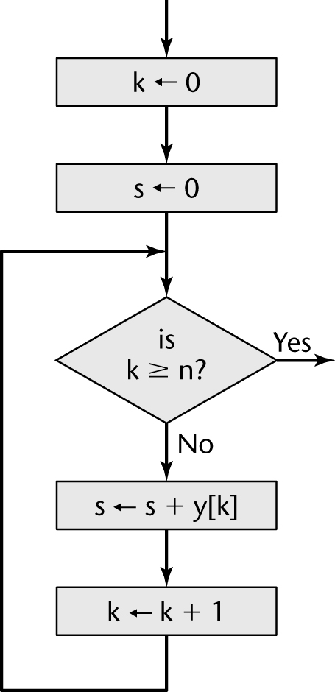
Example of a Correctness Proof (contd)
A flowchart equivalent of the code segment

Slide 49
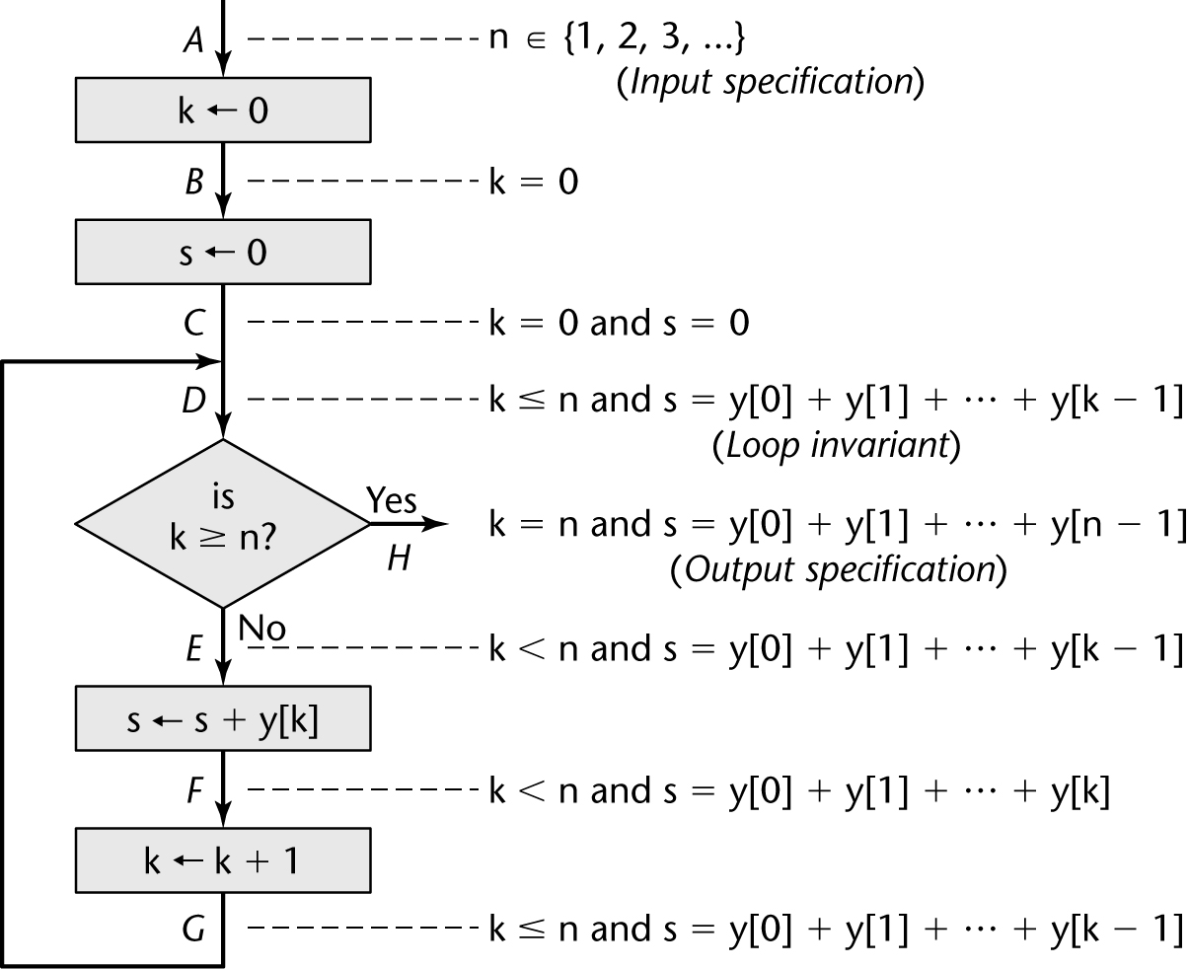
Example of a Correctness Proof (contd)
Add
Input specification
Output specification
Loop invariant
Assertions

Slide 50
Example of a Correctness Proof (contd)
An informal proof using induction appears in Section 6.5.1
Automated Theorem Provers

Slide 51
Model Checking for Correctness
Exhaustively and automatically check whether a model meets its given specification.
  If not, counterexample is given
Notable Open Source Model Checkers
  Java Pathfinder: http://babelfish.arc.nasa.gov/trac/jpf
  SPIN: http://spinroot.com/spin/whatispin.html
  NuSMV: http://nusmv.fbk.eu/

Slide 52
Java Pathfinder
public class Racer implements Runnable {
int d = 42;
public void run () {
doSomething(1001);
d = 0; // (1)
}
public static void main (String[] args){
Racer racer = new Racer();
Thread t = new Thread(racer);
t.start();
doSomething(1000);
int c = 420 / racer.d; // (2)
System.out.println(c);
}
static void doSomething (int n) {
try { Thread.sleep(n); } catch (InterruptedException ix) {}
}
}

Slide 53
Java Pathfinder - cont
Division by zero: A race condition between two threads accessing the same variable d in (1) and (2)
JPF can find the error and show a counter example leading to the error
====== error #1
gov.nasa.jpf.listener.PreciseRaceDetector
race for field Racer@13d.d
main at Racer.main(Racer.java:16)
"int c = 420 / racer.d; " : getfield
Thread-0 at Racer.run(Racer.java:7)
"d = 0; " : putfield
====== trace #1
---- transition #0 thread: 0
...
---- transition #3 thread: 1
gov.nasa.jpf.jvm.choice.ThreadChoiceFromSet[id="sleep",isCascaded:false,{main,>Thread-0}]
[3 insn w/o sources]
Racer.java:22 : try { Thread.sleep(n); } catch (InterruptedException ix) {}
Racer.java:23 : }
Racer.java:7 : d = 0;
---- transition #5 thread: 0
gov.nasa.jpf.jvm.choice.ThreadChoiceFromSet[id="sharedField",isCascaded:false,{>main,Thread-0}]
Racer.java:16 : int c = 420 / racer.d;

Slide 54
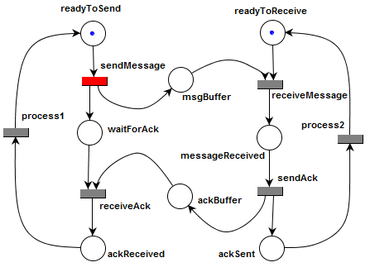
MISTA

Slide 55
MISTA: Reachability Graph
readyToSend, readyToReceive
sendMessage
waitForAck, msgBuffer, readyToReceive
receiveMessage
waitForAck, messageReceived
process1
sendAck
waitForAck, ackBuffer, ackSent
receiveAck
process2
ackReceived, ackSent
waitForAck, ackBuffer, readyToReceive
receiveAck
process2
process2
ackReceived, readyToReceive
process1
process2
readyToSend, ackSent
waitForAck, msgBuffer, ackSent
sendMessage

Slide 56
Verification in MISTA
Reachability
Deadlock
Assertions

Slide 57
Myths of Correctness Proving
Software engineers do not have enough mathematics for proofs
  Most CS majors either know or can learn the mathematics needed for proofs
Proving is too expensive to be practical
  Determine economic viability by cost–benefit analysis
Proving is too hard
  Nontrivial products have been successfully proven
  Theorem provers and model checkers can assist us

Slide 58
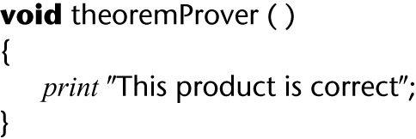
Difficulties with Correctness Proving
Can we trust a theorem prover /model checker?
  LTSA experience: no counterexample for p and !p
How do we find specifications and properties?
What if the specifications are wrong?
We can never be sure that specifications or a verification system are correct

Slide 59
